Slide 1
Windshield survey
Mexico Community

Slide 2
Introduction
Mexico is a country of southern North America.
Is the third largest country of Latin America.
Mexico has an array of interesting and unique geographical features.
It is among the most fascinating areas to explore in the world.
The community is characterized by extremes of wealth and poverty.
An economic and political force in Latin America.
Notes:
Mexico is defined by the unique geographical features. It is a land of extremes, with high mountains and deep canyons in the center of the country, sweeping deserts in the north, and dense rain forests in the south and east. Mountains cover much of Mexico. Mexican society is characterized by extremes of wealth and poverty, with a limited middle class wedged between an elite cadre of landowners and investors on the one hand and masses of rural and urban poor on the other. But in spite of the challenges it faces as a developing country, Mexico is one of the chief economic and political forces in Latin America.

Slide 3
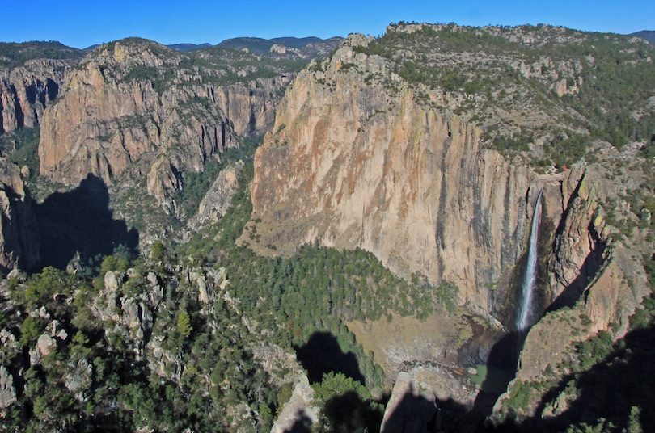
Basasea chick Falls park
Basasea Chick Falls Park is an example of the exceptional scenes in Mexico, one of the community assets.

Slide 4
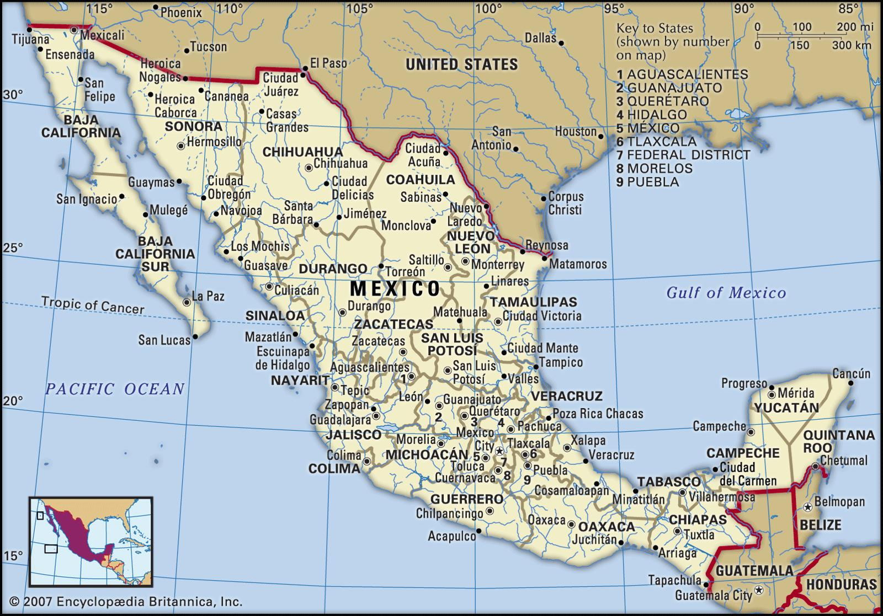
Introduction Cont…
Houses in the community are based are influenced by many American architectural design.
Some houses are as old as when Mexico was established in 1324.
Air pollution is common while others such as water and land pollution exist in the community.
Notes:
Mexican houses are as old as since when Mexico was built in 1324, actually there are various types of houses in Mexico, which has influenced many American architectural designs many houses are with white stucco walls and red tile roofs they have several arched and rounded windows, and their doors usually wooden, most have interior floors tiled. The most common type of pollution in Mexico is air pollution, caused by hydrocarbons released into the air. Equally, there is a lack adequate clean water and deforestation, and this evidenced through the clearing of the forest. There are signs of land pollution seen through deposition of solid waste particularly garbage.

Slide 5
Introduction Cont…
Recreation facilities in the community include swimming pools, playing grounds, and public shower facilities for adults, among others.
people sunbath, fish, play tennis, do picnics, as part of recreation.
Transport network in Mexico is extensive with presence of roads, airport, and railway lines.
People also cycle and walk around the streets congested with cars.
Regarding the community’s security, there are excellent protection services.
Police are everywhere in the streets, firefighting services are readily available as well as sewerage services.
Notes:
In Mexico, there are fair playing grounds, swimming pools, and shower facilities and recreational space for adults, which are well. Maintained by the recreation department, You may want to spend a leisurely afternoon sunning, swimming, picnicking, fishing, playing tennis, watching, or relaxing.
The Mexican community also has an extensive transportation networking; a spot check through the windshield survey results shows the prevalence of public transport with several buses and taxis. People also cycle and walk around the streets while the existence of airports and railway lines guarantees use of flight and trains for transport. Cars experience greater traffic congestion, pollution, and road safety challenges due to the large numbers and ineffective planning of the transportation network in the streets.
There is excellent evidence of protection services in Mexico, with police seen on the streets, with firefighting and control vehicles seen on the streets. And also vehicles offering sewerage facilities taking a ride around Mexico with water treatment facilities in the scene.

Slide 6
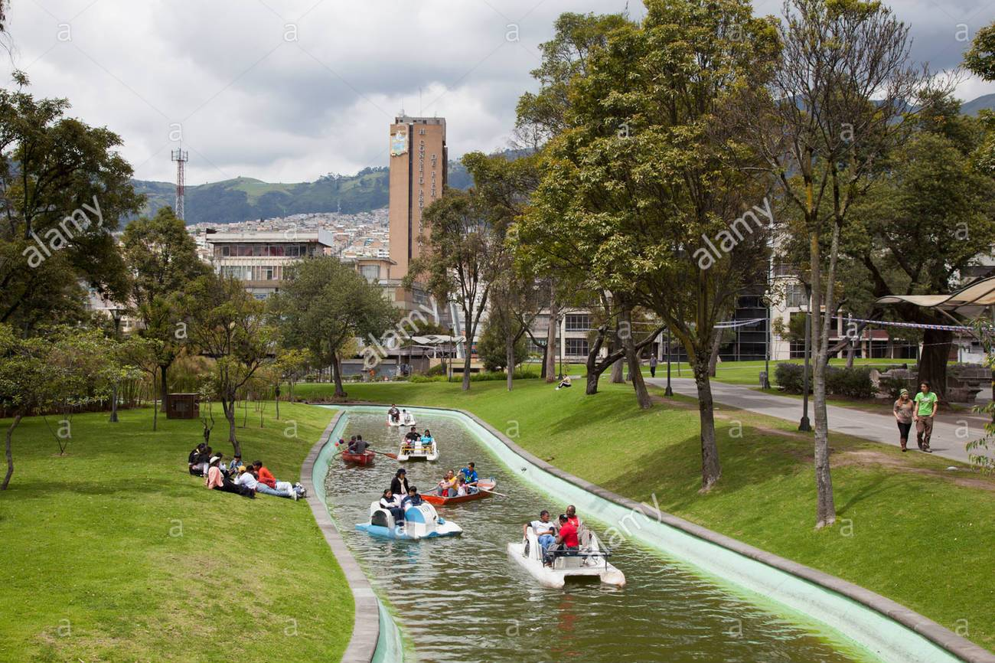
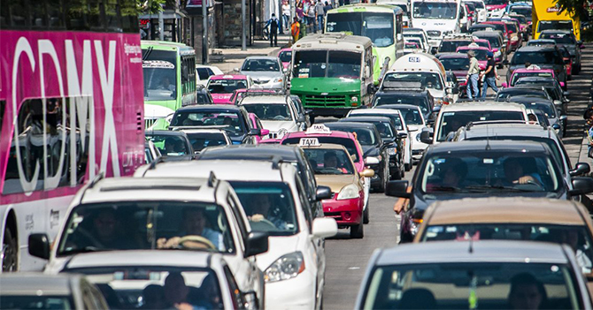
Alameda park photocredit@Alamy
Photo credit @ Mexico news network

Slide 7
Introduction Cont…
Christianity is the dominant religion with Churches all over the community.
International schools dominate education in Mexican city with several elementary, high school, colleges, and universities also present.
Healthcare system comprise of public and private hospitals with several pharmaceutical shops across the streets; quality services are offered.
The community comprise of several ethnic groups including Amerindians, Mexican of European heritage, indigenous Mexicans.
Main language is Spanish.
There are two dominant political parties while gangs continue terrorize people in the Mexican society.
Notes:
Christianity is the dominant religion in Mexico, with many churches observed around the Mexican city, Catholic churches are dominant with various Protestant and Mormonism churches seen around and nonchristian religions such as Islam, Buddhism, and paganism constituting less than 10 percent in Mexico.
There are many international schools in the Mexican city, with also many urban public schools and also several private schools. Several high schools, elementary, intermediate and also colleges and universities widely concentrated within the Mexican city.
There are both private and public healthcare systems in Mexico with the quality of this facility being high; there are also several pharmaceutical shops in the streets this shows the level of seriousness the government and the people of Mexico have. To ascertain their efforts of putting in place sustainable healthcare systems.
Generally speaking, Mexico constute of several ethnic groups, with Amerindians and Mexicans of European heritage also taking the lead. The indigenous Mexican people have intermarried. Spanish is the national language.
Politically, there are more than two dominant political parties in Mexico, but prevalence is given to those parties that secure representation in Congress.
There are several gangs within the Mexican city, with the government seriously addressing criminality and extremism as seen in the billboards and posters within the Mexican streets.

Slide 8
Subjective Feelings
A ride around the community is a fantastic and memorable one.
People are very welcoming.
The people of Mexico have a general culture of welcoming people.
There are unique cuisines, music , and architecture.
The community has a Unique History which depicts its unique features
There are diverse culture and good terrain which supports people form different backgrounds.
Notes:
It feels fantastic taking a ride in Mexico, the people are welcoming and generous, Mexico has its uniqueness in it cuisines music clothing, architecture and history which can also be felt notable is the landscape which can not be compared to any other. However, I would not prefer working or living in Mexico since there are few opportunities to grow economically which limits one's potential, justifying the reason why many Mexicans go to the US and also there are high poverty levels with corruption at its the peak.

Slide 9
Subjective Feelings
Mexico is a place I would want to live with my family or even work.
Discrimination or any form of prejudice is limited or existent in the Mexican community.
Individual autonomy is highly valued and people respect each other’s culture.
The economy is still fragile despite stronger partnerships with the U.S. and Canada.
Work environment is favorable with private investments the most welcomed areas of economic improvement by the residents of the community.
Notes:
Mexico is a place I would want to live with my family or even work. Discrimination or any form of prejudice is limited or existent in the Mexican community. Individual autonomy is highly valued and people respect each other’s culture. The economy is still fragile despite stronger partnerships with the U.S. and Canada. Work environment is favorable with private investments the most welcomed areas of economic improvement by the residents of the community.

Slide 10
Subjective Feelings Cont…
The community has strong attachment to music and native dances.
English songs are also often played in the community
I observed two of the songs that are my favorite and still popular in the Mexican community:
https://www.youtube.com/watch?v=Rjw0AhiC0x0 and https://www.youtube.com/watch?v=ao-xiKd8E2M
Notes:
People love classic American music apart from the Community-based music. The community has strong attachment to music and native dances. English songs are also often played in the community

Slide 11
Community needs
Through the survey, a number of problems were observed that need to be addressed in the community:
Air pollution: for the sake of the community’s health, air pollution need to be addressed. It is the most prevalent in Mexico.
The air quality needs to be improved
Fix the sources of pollution by:
    By introductions of cleaner forms of energy
    Civic education on environmental conservation
    Educational Campaigns.
Notes:
The gap that exists in Mexico is dealing with air pollution menace, and air pollution has concerned Mexicans, environmentalist and even health experts, the city's pollution continues to spread out, the linkage has been made between the high school absenteeism among the children and even heart problems among the elderly, and causes of childhood asthmas.

Slide 12
Community Needs Cont…
Reaforestation is also needed in the community.
Most parts of the community have become arid and semi-arid due to the land pollution.
People cut trees without planting new ones.
This has resulted to climate change; also facilitated by air pollution.
Existence of gangs continue to threaten the security of the community.
The gangs run drug business in the community.
Need to be addressed to save the face of future generation.
Notes:
The Mexican government should take seriously, the pollution menace and put in place intervention measures, measures such as curbing deforestation but rather should intervene in doing civic education and reaforestation. Existence of gangs continue to threaten the security of the community. The gangs run drug business in the community. There is need to address this issues to save the face of future generation.

Slide 13
Community Strengths
Mexico has a rich geographical and cultural diversity.
it boast of more than 11,000 km coastline and diverse terrain ranging from mountains, forest, to desert.
It is an indigenous city and enjoys free trade with many of its neighbors.
It has established itself as a prime location for companies exporting to the world largest economy, America.
Therefore, it attracts significant investment.
Furthermore, it enjoys a diverse culture reflected by its cuisines
Notes:
Mexico has a rich geographical and cultural diversity; it boast of more than 11,000 coastline and diverse terrain ranging from mountains, forest to desert as well as it being an indigenous city and enjoys free trade and has established itself as a prime location for companies exporting to the world largest economy. Therefore it attracts significant investment. Furthermore, it enjoys a diverse culture reflected in its cuisines, therefore Mexico has a higher capability to do more and improve its economy and the life of its citizens.

Slide 14
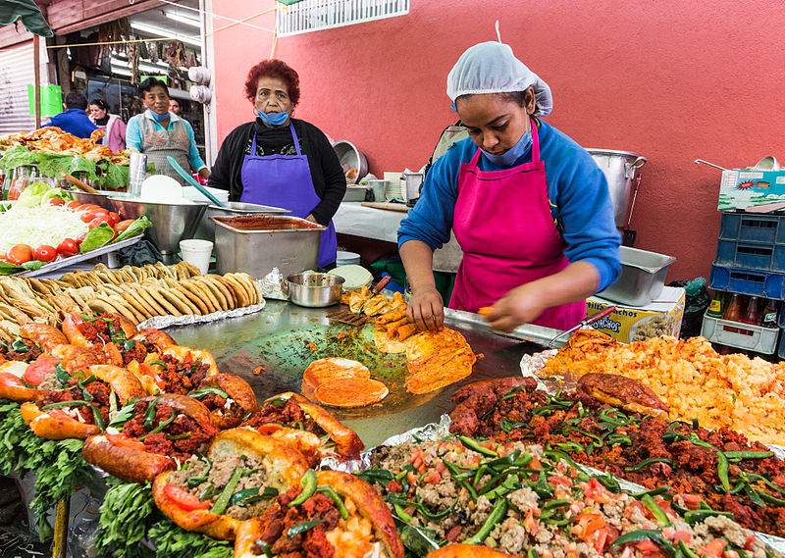
Community Strengths Cont…
The restaurant displays the cultural diversity of Mexico where food is prepared differently.
A local restaurant in Mexico

Slide 15
Conclusion
Mexico is one of the best cities in the world.
With well developed infrastructure of roads, schools, the healthcare system, and security, among others.
It is a rich culture that is accommodative.
Only issue in the community is that of pollution and gangs disturbance.
Otherwise its location allows it to be an investment as well as a recreational hub.

